Slide 1
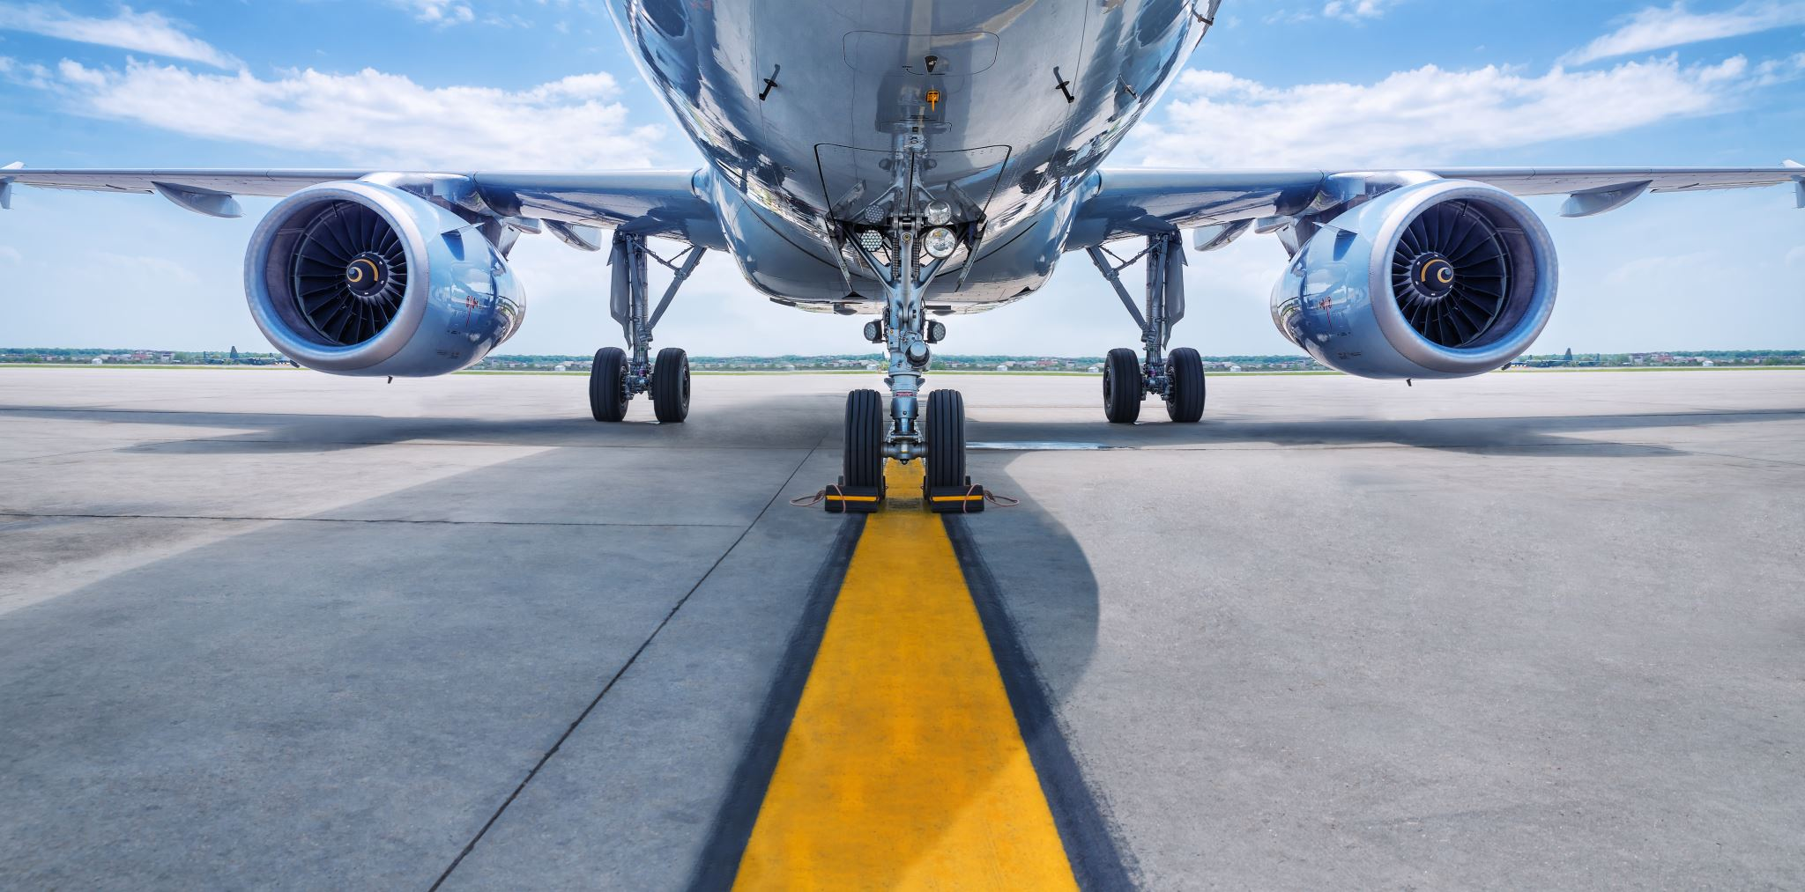
A Safety and Success Review
Bilal Kudaimi
Star Airlines
October 10th, 2021

Slide 2
Rising Customer Satisfaction
Customers are happy with flying
Source: American Customer Satisfaction Index

Slide 3
High Travel Demand
Airline demand has peaked as of the last 5 years
Source: US Bureau of Transportation Statistics

Slide 4
Star Airlines: Successful
Revenue is at an all-time high
Source: US Bureau of Transportation Statistics

Slide 5




Changing Media Opinion
Despite high consumer satisfaction and revenue, current media is reporting negatively about us due to a few unfortunate crashes
See #2 on right chart
Star Airlines stands to lose a lot if chart is allowed to continue past 2
1
A few unfortunate recent accidents
2
Negative press regarding our safety
→
→
3
Changing public opinion/scrutiny
4
Negatively impacted sales
→

Slide 6
What does the data say about safety?
Accident percent is lowest ever (0.2% of flights as of 2017)
Source: US Federal Aviation Administration

Slide 7
What does the data say about safety?
There were almost no fatal accidents in the last decade
2018-2019 reflects the recent unfortunate accidents
Source: US National Safety Council

Slide 8
What does the data say about safety?
Air travel in general is the safer travel option
Current negative PR has no basis
Source: US NHTSA, US Coast Guard, Bureau of Aircraft Accidents Archives

Slide 9

So then, what is the solution?

Slide 10



PR Campaign
Star Airlines needs to combat fears with facts
1
Social media outreach to share Star Airlines’ findings
2
Infographic to consumers about what makes flying safe
3
Outreach video to further inform the public of our data
→
→

Slide 11
Q&A

